Slide 1
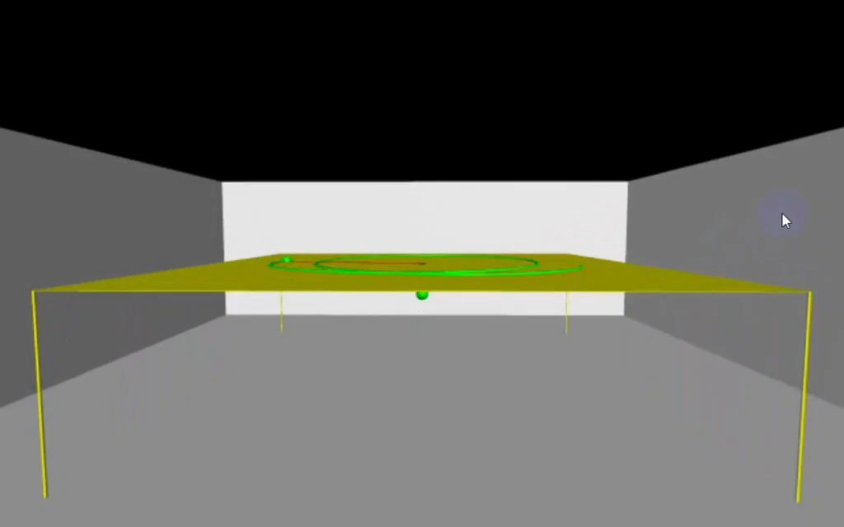

Slide 2
DYNAMICS ANALYSIS OF A TWO-BODY SYSTEM
USING NUMERICAL METHODS
Presented by
Muhaimenur Rahman
Reg.no: 2017132009
Session: 2017-18

Slide 3
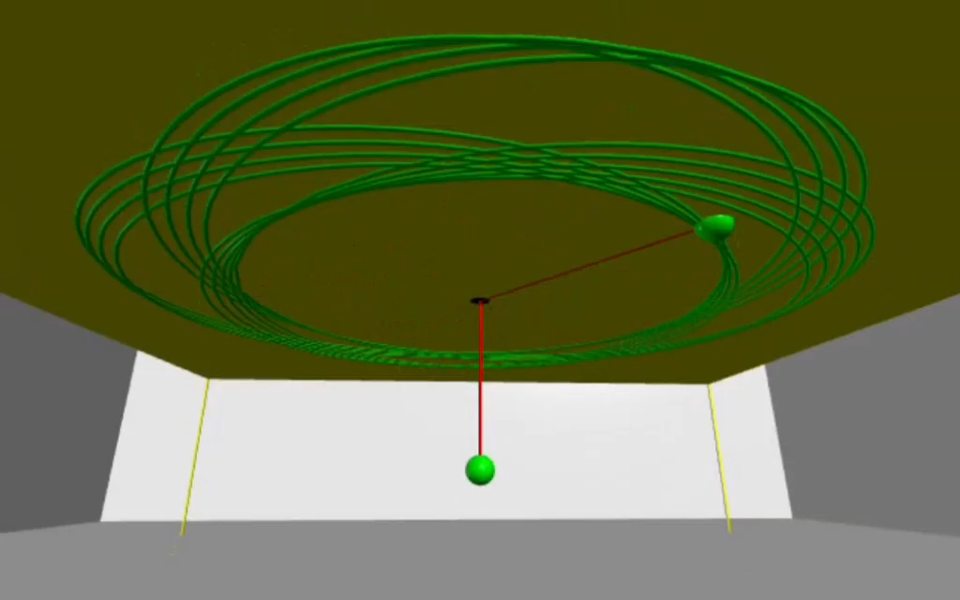

Slide 4
OUTLINE
System descriptions
Euler-Lagrange equations
Numerical methods
Analysis and results
Conclusion

Slide 5
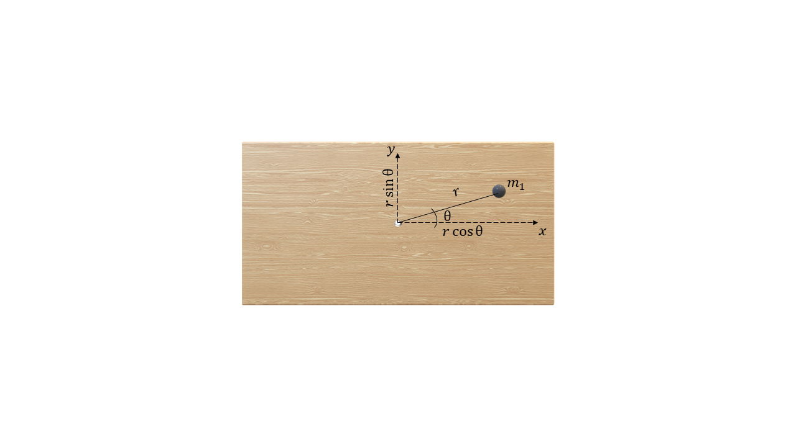
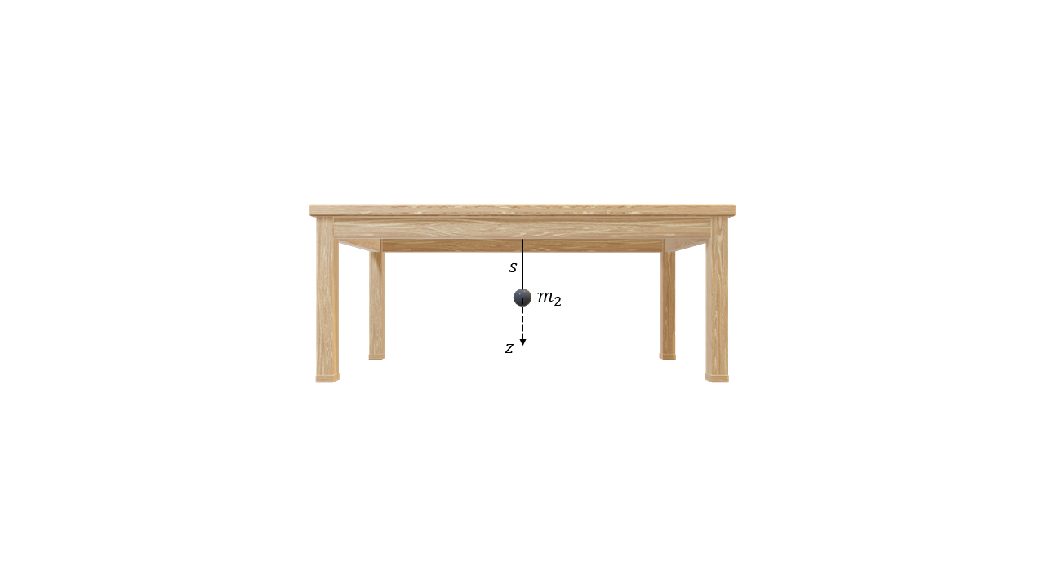
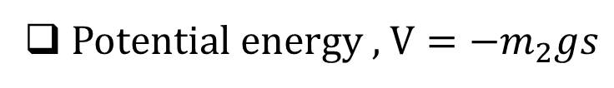
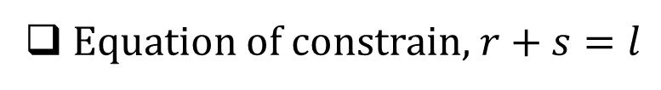
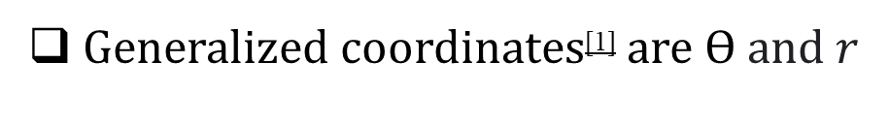
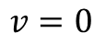
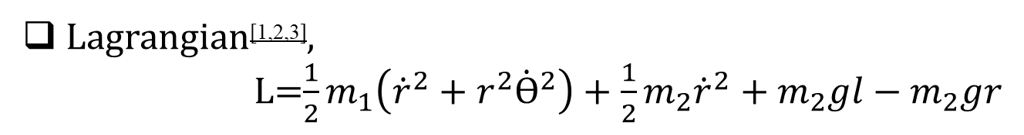
SYSTEM DESCRIPTION
1
String is massless
Surface is frictionless
Equation of constrain, $r+s=l$
$$v=0$$
Kinetic energy , $T=\frac{1}{2}m_{1}\left({\dot{r}}^{2}+r^{2}{\dot{\text{θ}}}^{2}\right)+\frac{1}{2}m_{2}{\dot{s}}^{2}$
Potential energy , $V=−m_{2}gs$
Generalized coordinates^{[1]} are $Ɵ$ and $r$
Lagrangian^{[1,2,3]},
L=$\frac{1}{2}m_{1}\left({\dot{r}}^{2}+r^{2}{\dot{Ɵ}}^{2}\right)+\frac{1}{2}m_{2}{\dot{r}}^{2}+m_{2}gl−m_{2}gr$

Slide 6
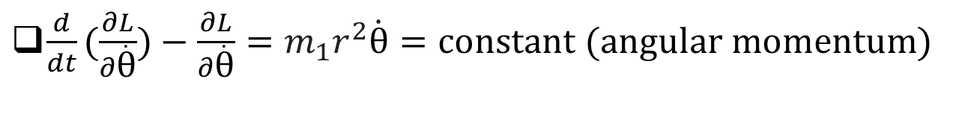
EULER-LAGRANGE EQUATIONS
^{[1]}
2
$\frac{d}{dt}\left(\frac{∂L}{∂\dot{r}}\right)−\frac{∂L}{∂\dot{r}}=\left(m_{1}+m_{2}\right)\ddot{r}−m_{1}r{\dot{\text{θ}}}^{2}+m_{2}g=0$
$\frac{d}{dt}(\frac{∂L}{∂\dot{\text{θ}}})−\frac{∂L}{∂\dot{\text{θ}}}=m_{1}r^{2}\dot{\text{θ}}=constant (angular momentum)$

Slide 7
NUMERICAL METHODS
^{[4,5]}
3
Euler Method
4th Order Runge Kutta Method

Slide 8
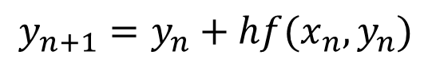
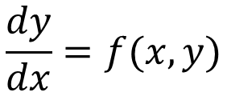
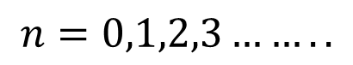
EULER METHOD
4
Differential equation,
$$\frac{dy}{dx}=f(x,y)$$
Solution,
$$y_{n+1}=y_{n}+hf(x_{n},y_{n})$$
where,
$$n=0,1,2,3……..$$

Slide 9
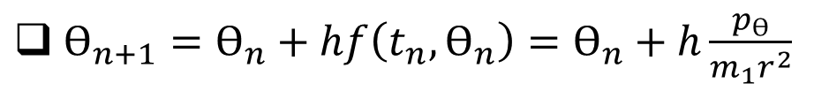
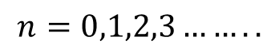
SOLUTIONS OF THE EQUATION OF MOTION BY EULER METHOD
5
$Ɵ_{n+1}=Ɵ_{n}+hf\left(t_{n},Ɵ_{n}\right)=Ɵ_{n}+h\frac{p_{Ɵ}}{m_{1}r^{2}}$
$r_{n+1}=r_{n}+hq\left(t_{n},r_{n},v_{r_{n}}\right)=r_{n}+hv_{r_{n}}$
$v_{r_{n+1}}=v_{r_{n}}+hs\left(t_{n},r_{n},v_{r_{n}}\right)=v_{r_{n}}+h(\frac{{p_{Ɵ}}^{2}}{m_{1}(m_{1}+m_{2})r_{n}^{3}}−\frac{m_{2}g}{m_{1}+m_{2}})$
where,
$$n=0,1,2,3……..$$

Slide 10
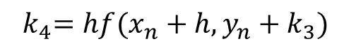
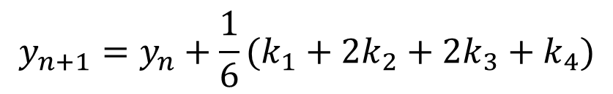
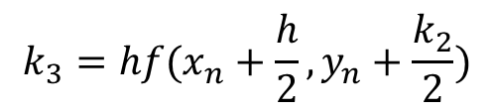
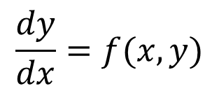
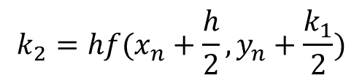
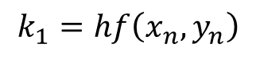
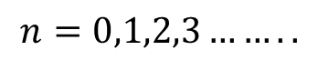
4TH ORDER RUNGE KUTTA METHOD
6
Differential equation,
$$\frac{dy}{dx}=f(x,y)$$
Solution,
$$y_{n+1}=y_{n}+\frac{1}{6}(k_{1}+2k_{2}+2k_{3}+k_{4})$$
where,
$$n=0,1,2,3……..$$
$$k_{1}=hf\left(x_{n},y_{n}\right)$$
$$k_{2}=hf(x_{n}+\frac{h}{2},y_{n}+\frac{k_{1}}{2})$$
$$k_{3}=hf(x_{n}+\frac{h}{2},y_{n}+\frac{k_{2}}{2})$$
$${ k}_{4}=hf(x_{n}+h,y_{n}+k_{3})$$

Slide 11
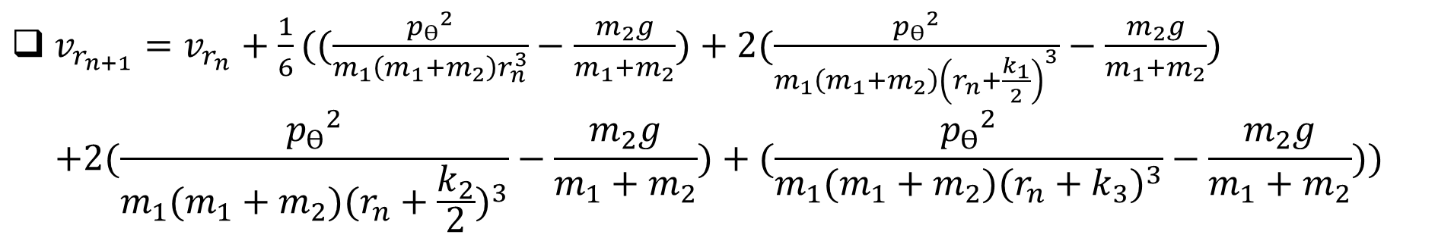
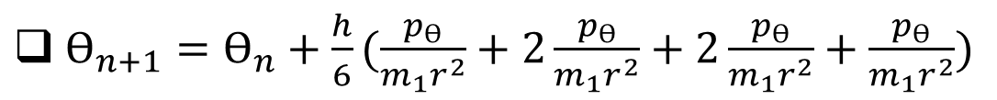
SOLUTIONS OF THE EQUATION OF MOTION BY 4TH ORDER RUNGE KUTTA METHOD
7
$Ɵ_{n+1}=Ɵ_{n}+\frac{h}{6}(\frac{p_{Ɵ}}{m_{1}r^{2}}+2\frac{p_{Ɵ}}{m_{1}r^{2}}+2\frac{p_{Ɵ}}{m_{1}r^{2}}+\frac{p_{Ɵ}}{m_{1}r^{2}})$
$r_{n+1}=r_{n}+\frac{1}{6}(hv_{r_{n}}+2h(v_{r_{n}}+\frac{l_{1}}{2})+2h(v_{r_{n}}+\frac{l_{2}}{2})+h(v_{r_{n}}+l_{3}))$
$v_{r_{n+1}}=v_{r_{n}}+\frac{1}{6}((\frac{{p_{Ɵ}}^{2}}{m_{1}\left(m_{1}+m_{2}\right)r_{n}^{3}}−\frac{m_{2}g}{m_{1}+m_{2}})+2(\frac{{p_{Ɵ}}^{2}}{m_{1}\left(m_{1}+m_{2}\right){\left(r_{n}+\frac{k_{1}}{2}\right)}^{3}}−\frac{m_{2}g}{m_{1}+m_{2}})$
$$+2(\frac{{p_{Ɵ}}^{2}}{m_{1}(m_{1}+m_{2}){(r_{n}+\frac{k_{2}}{2})}^{3}}−\frac{m_{2}g}{m_{1}+m_{2}})+(\frac{{p_{Ɵ}}^{2}}{m_{1}(m_{1}+m_{2}){(r_{n}+k_{3})}^{3}}−\frac{m_{2}g}{m_{1}+m_{2}}))$$
where,
$$n=0,1,2,3……..$$

Slide 12
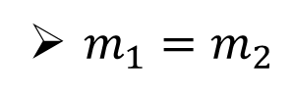
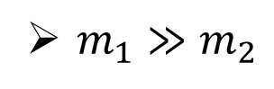
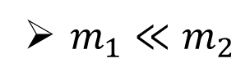
ANALYSIS AND RESULTS
8
Energy vs Time
Equilibrium Condition
Difference between the methods for different values of h
Different Angular Momentum
Different Mass Conditions
$m_{1}≪m_{2}$
$m_{1}≫m_{2}$
$m_{1}=m_{2}$
Comparison between $m_{1}≪m_{2}$, $m_{1}≫m_{2}$ and $m_{1}=m_{2}$

Slide 13
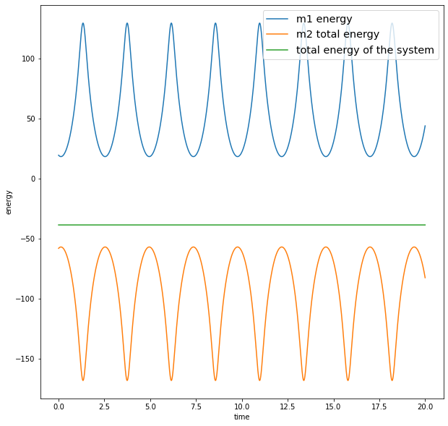
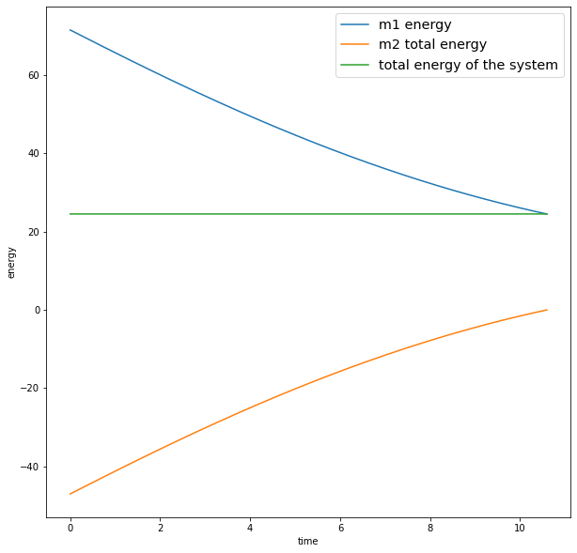
ENERGY VS TIME
9

Slide 14
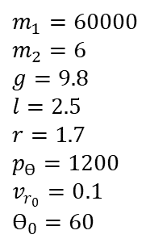
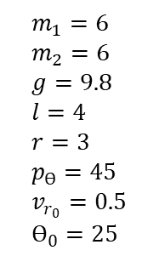
ENERGY VS TIME
9
$$m_{1}=6 \\ m_{2}=6 \\ g=9.8 \\ l=4 \\ r=3 \\ p_{Ɵ}=45 \\ v_{r_{0}}=0.5 \\ Ɵ_{0}=25$$
$$m_{1}=60000 \\ m_{2}=6 \\ g=9.8 \\ l=2.5 \\ r=1.7 \\ p_{Ɵ}=1200 \\ v_{r_{0}}=0.1 \\ Ɵ_{0}=60$$

Slide 15
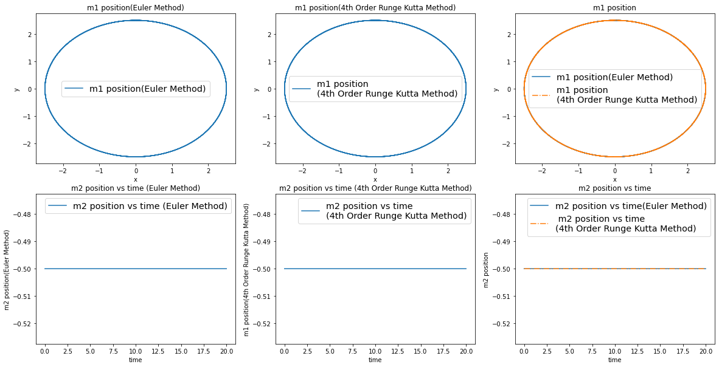
EQUILIBRIUM CONDITION, $p_{Ɵ}=\sqrt{m_{1}m_{2}gr^{3}}$
10
$m_{1}=10, m_{2}=5, g=9.8, p_{Ɵ}=87.5,l=3, r=2.5, v_{r_{0}}=0, Ɵ_{0}={15}^{0}$

Slide 16
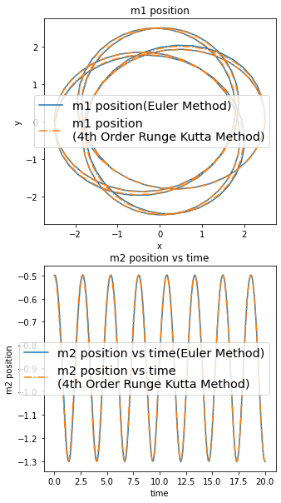
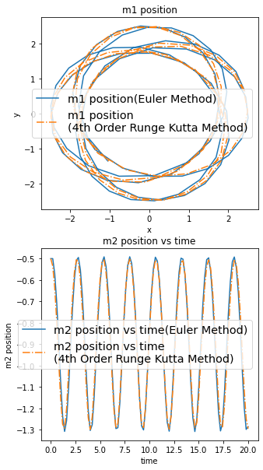
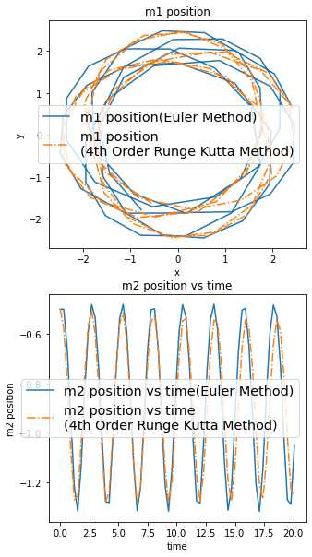
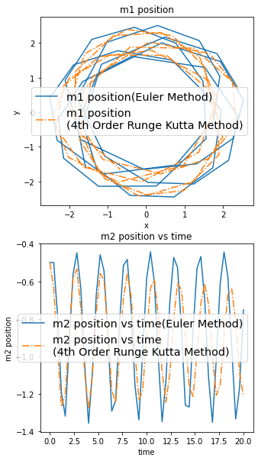
DIFFERENCE BETWEEN THE METHODS
FOR DIFFERENT VALUES OF h
11
$$m_{1}=6, m_{2}=4, g=9.8, p_{Ɵ}=45, l=3, r=2.5, v_{r_{0}}=0, Ɵ_{0}={15}^{0}$$

Slide 17
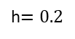
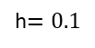
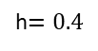
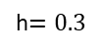
DIFFERENCE BETWEEN THE METHODS
FOR DIFFERENT VALUES OF h
11
$$m_{1}=6, m_{2}=4, g=9.8, p_{Ɵ}=45, l=3, r=2.5, v_{r_{0}}=0, Ɵ_{0}={15}^{0}$$
h$=0.1$
h$=0.2$
h$=0.3$
h$=0.4$

Slide 18
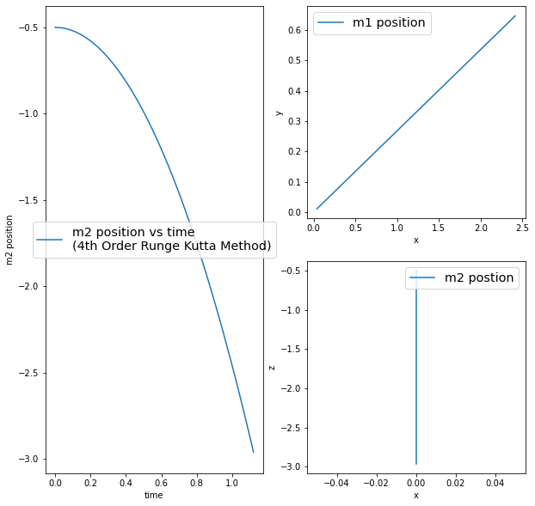
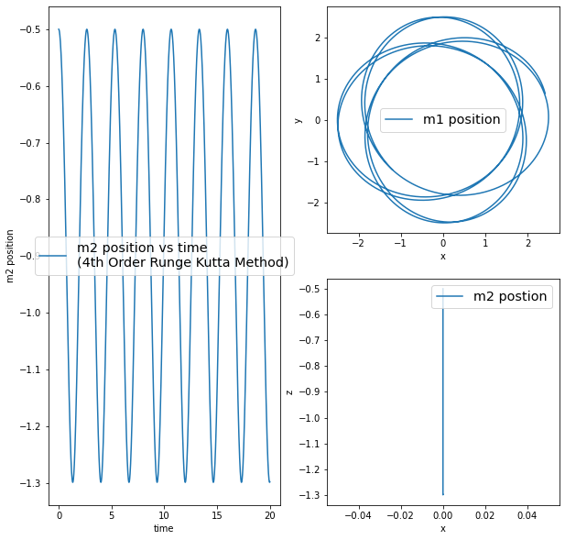
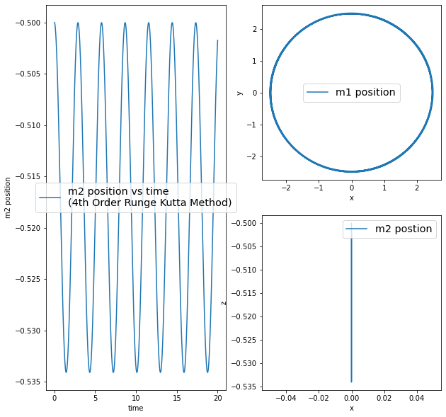
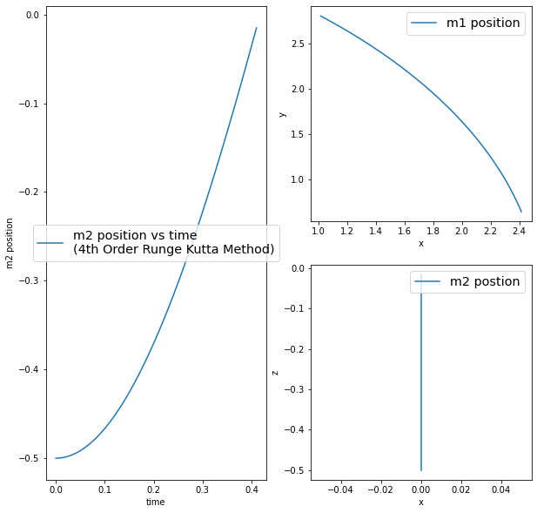
DIFFERENT ANGULAR MOMENTUM
12

Slide 19
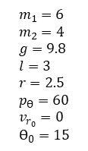
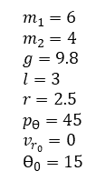
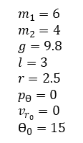
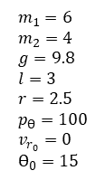
DIFFERENT ANGULAR MOMENTUM
12
$$m_{1}=6 \\ m_{2}=4 \\ g=9.8 \\ l=3 \\ r=2.5 \\ p_{Ɵ}=0 \\ v_{r_{0}}=0 \\ Ɵ_{0}=15$$
$$m_{1}=6 \\ m_{2}=4 \\ g=9.8 \\ l=3 \\ r=2.5 \\ p_{Ɵ}=45 \\ v_{r_{0}}=0 \\ Ɵ_{0}=15$$
$$m_{1}=6 \\ m_{2}=4 \\ g=9.8 \\ l=3 \\ r=2.5 \\ p_{Ɵ}=60 \\ v_{r_{0}}=0 \\ Ɵ_{0}=15$$
$$m_{1}=6 \\ m_{2}=4 \\ g=9.8 \\ l=3 \\ r=2.5 \\ p_{Ɵ}=100 \\ v_{r_{0}}=0 \\ Ɵ_{0}=15$$

Slide 20
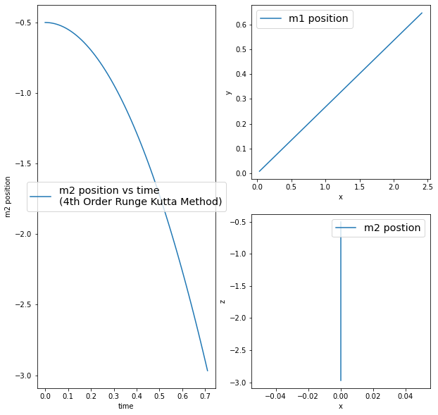

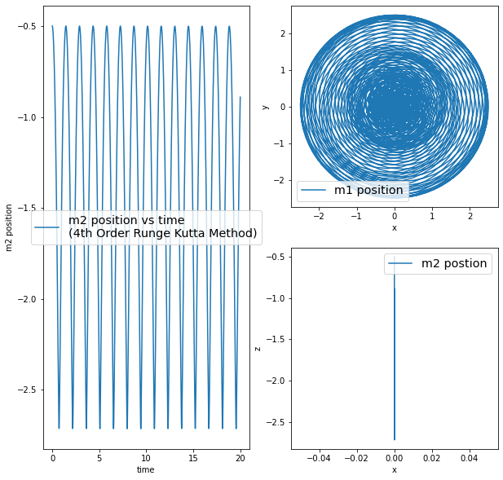


DIFFERENT MASS CONDITIONS
13
Comparison between $m_{1}≪m_{2}$ and $m_{1}<m_{2}$

Slide 21





DIFFERENT MASS CONDITIONS
13
Comparison between $m_{1}≪m_{2}$ and $m_{1}<m_{2}$
$$m_{1}=1 \\ m_{2}=1000 \\ g=9.8 \\ l=3 \\ r=2.5 \\ p_{Ɵ}=0 \\ v_{r_{0}}=0 \\ Ɵ_{0}=15$$
$$m_{1}=4 \\ m_{2}=6 \\ g=9.8 \\ l=3 \\ r=2.5 \\ p_{Ɵ}=0 \\ v_{r_{0}}=0 \\ Ɵ_{0}=15$$
$$m_{1}=1 \\ m_{2}=1000 \\ g=9.8 \\ l=3 \\ r=2.5 \\ p_{Ɵ}=60 \\ v_{r_{0}}=0 \\ Ɵ_{0}=15$$
$$m_{1}=4 \\ m_{2}=6 \\ g=9.8 \\ l=3 \\ r=2.5 \\ p_{Ɵ}=60 \\ v_{r_{0}}=0 \\ Ɵ_{0}=15$$

Slide 22



DIFFERENT MASS CONDITIONS
14
Comparison between $m_{1}≫m_{2}$ and $m_{1}>m_{2}$

Slide 23





DIFFERENT MASS CONDITIONS
14
Comparison between $m_{1}≫m_{2}$ and $m_{1}>m_{2}$
$$m_{1}=1000 \\ m_{2}=1 \\ g=9.8 \\ l=3 \\ r=2.5 \\ p_{Ɵ}=0 \\ v_{r_{0}}=0 \\ Ɵ_{0}=15$$
$$m_{1}=6 \\ m_{2}=4 \\ g=9.8 \\ l=3 \\ r=2.5 \\ p_{Ɵ}=0 \\ v_{r_{0}}=0 \\ Ɵ_{0}=15$$
$$m_{1}=1000 \\ m_{2}=1 \\ g=9.8 \\ l=3 \\ r=2.5 \\ p_{Ɵ}=60 \\ v_{r_{0}}=0 \\ Ɵ_{0}=15$$
$$m_{1}=6 \\ m_{2}=4 \\ g=9.8 \\ l=3 \\ r=2.5 \\ p_{Ɵ}=60 \\ v_{r_{0}}=0 \\ Ɵ_{0}=15$$

Slide 24



DIFFERENT MASS CONDITIONS
15
$$m_{1}=m_{2}$$

Slide 25





DIFFERENT MASS CONDITIONS
15
$$m_{1}=m_{2}$$
$$m_{1}=0.6 \\ m_{2}=0.6 \\ g=9.8 \\ l=3 \\ r=2.5 \\ p_{Ɵ}=0 \\ v_{r_{0}}=0 \\ Ɵ_{0}=15$$
$$m_{1}=60 \\ m_{2}=60 \\ g=9.8 \\ l=3 \\ r=2.5 \\ p_{Ɵ}=0 \\ v_{r_{0}}=0 \\ Ɵ_{0}=15$$
$$m_{1}=0.6 \\ m_{2}=0.6 \\ g=9.8 \\ l=6 \\ r=5 \\ p_{Ɵ}=0 \\ v_{r_{0}}=2 \\ Ɵ_{0}=25$$
$$m_{1}=60 \\ m_{2}=60 \\ g=9.8 \\ l=6 \\ r=5 \\ p_{Ɵ}=0 \\ v_{r_{0}}=2 \\ Ɵ_{0}=25$$

Slide 26



DIFFERENT MASS CONDITIONS
16
Comparison between $m_{1}≪m_{2}$, $m_{1}≫m_{2}$ and $m_{1}=m_{2}$
$$m_{1}=1 \\ m_{2}=1000 \\ g=9.8 \\ l=3 \\ r=2.5 \\ p_{Ɵ}=0 \\ v_{r_{0}}=0 \\ Ɵ_{0}=15$$
$$m_{1}=1000 \\ m_{2}=1 \\ g=9.8 \\ l=3 \\ r=2.5 \\ p_{Ɵ}=0 \\ v_{r_{0}}=0 \\ Ɵ_{0}=15$$
$$m_{1}=6 \\ m_{2}=6 \\ g=9.8 \\ l=6 \\ r=5 \\ p_{Ɵ}=0 \\ v_{r_{0}}=2 \\ Ɵ_{0}=25$$

Slide 27




DIFFERENT MASS CONDITIONS
17
Comparison between $m_{1}≪m_{2}$, $m_{1}≫m_{2}$ and $m_{1}=m_{2}$
$$m_{1}=1 \\ m_{2}=1000 \\ g=9.8 \\ l=3 \\ r=2.5 \\ p_{Ɵ}=60 \\ v_{r_{0}}=0 \\ Ɵ_{0}=15$$
$$m_{1}=1000 \\ m_{2}=1 \\ g=9.8 \\ l=3 \\ r=2.5 \\ p_{Ɵ}=60 \\ v_{r_{0}}=0 \\ Ɵ_{0}=15$$
$$m_{1}=6 \\ m_{2}=6 \\ g=9.8 \\ l=3 \\ r=2.5 \\ p_{Ɵ}=60 \\ v_{r_{0}}=0 \\ Ɵ_{0}=15$$

Slide 28
Conclusion
18
Numerical methods results match with theoretical results.
4th Order Runge Kutta Method and Euler Method give almost same results for lesser h values.
4th Order Runge Kutta Method gives more accurate results than Euler Method for higher h values.
Destroying time and time period are lesser in $m_{1}≪m_{2}$ than any other mass conditions.
Destroying time and time period are higher in $m_{1}≫m_{2}$ than any other mass conditions.
Destroying time is the same for all $m_{1}=m_{2}$ values at the same initial conditions.

Slide 29

References
Questions
[1] Baez, John C., and Derek K. Wise. "Lectures on classical mechanics." Manuscript.∗ This material is based upon work supported by the National Science Foundation under (2005).
[2] Goldstein, Herbert, Charles P. Poole, and John L. Safko. "Classical mechanics. 3rd." (2002).
[3] Taylor, John R. "Post-Use Review: Classical Mechanics." (2004): 559-559.
[4] Pang, Tao. "An introduction to computational physics." (1999): 94-95.
[5] Sastry, Shankar S. Introductory methods of numerical analysis. PHI Learning Pvt. Ltd., (2012).

Slide 30

Question
https://www.gettyimages.com/photos/question-mark

Slide 31

https://www.istockphoto.com/photo/thank-you-message-for-card-presentation-business-expressing-gratitude-acknowledgment-gm1397892955-452185473

